Slide 1
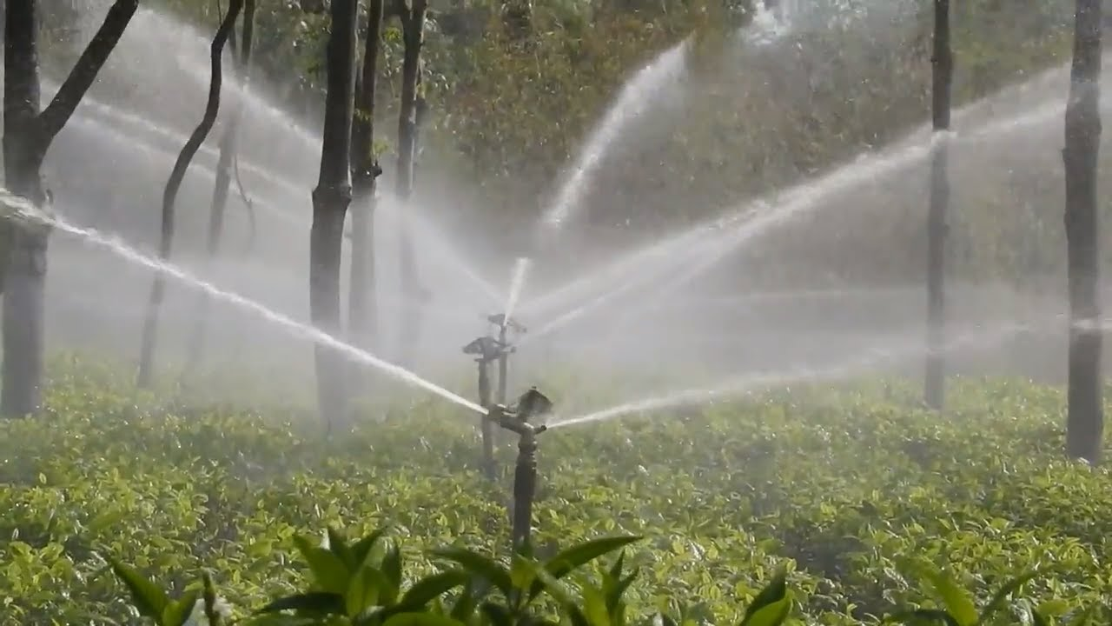
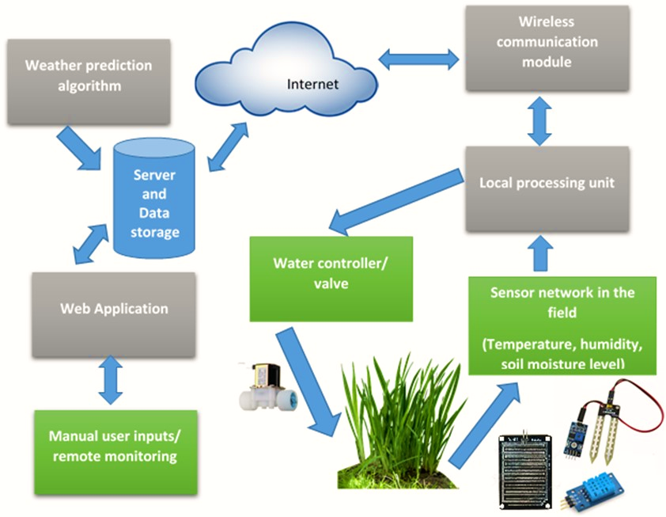
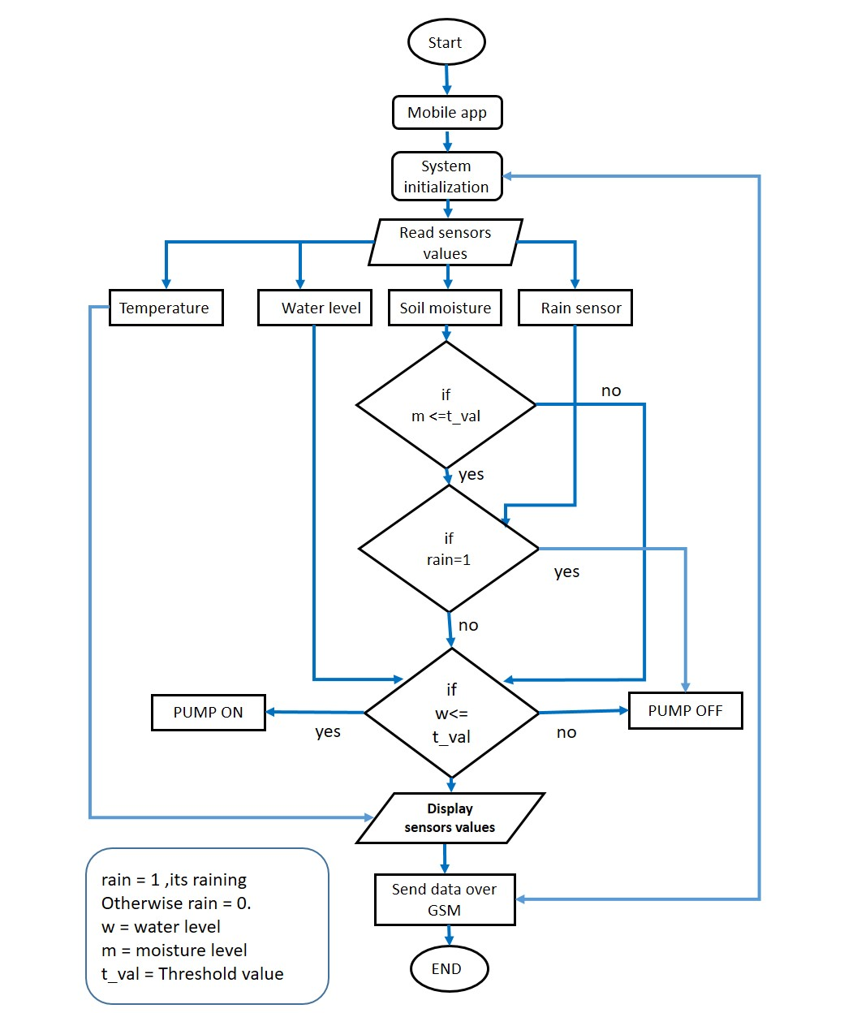
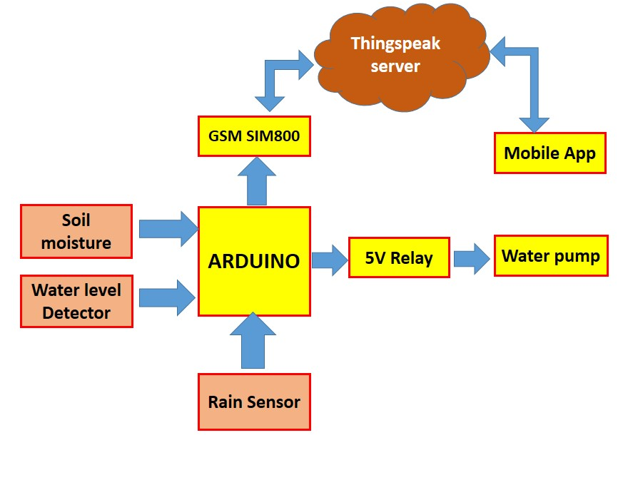
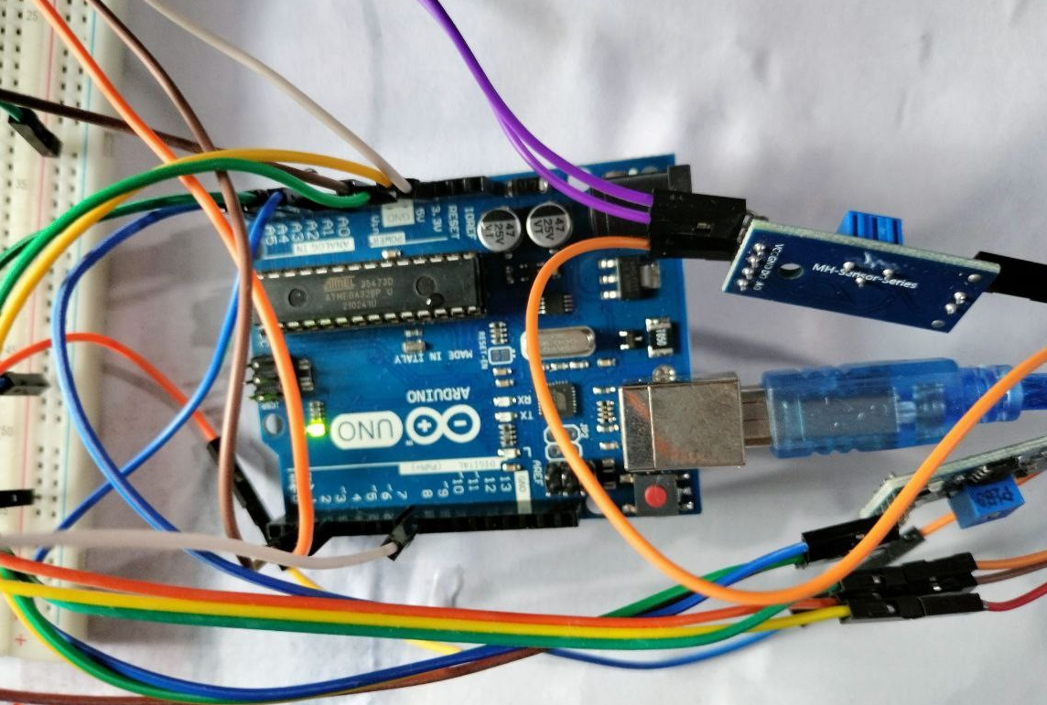
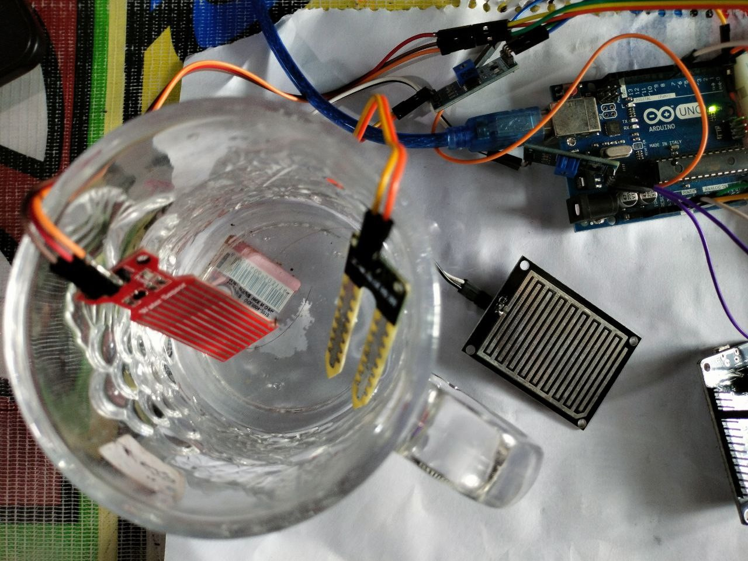
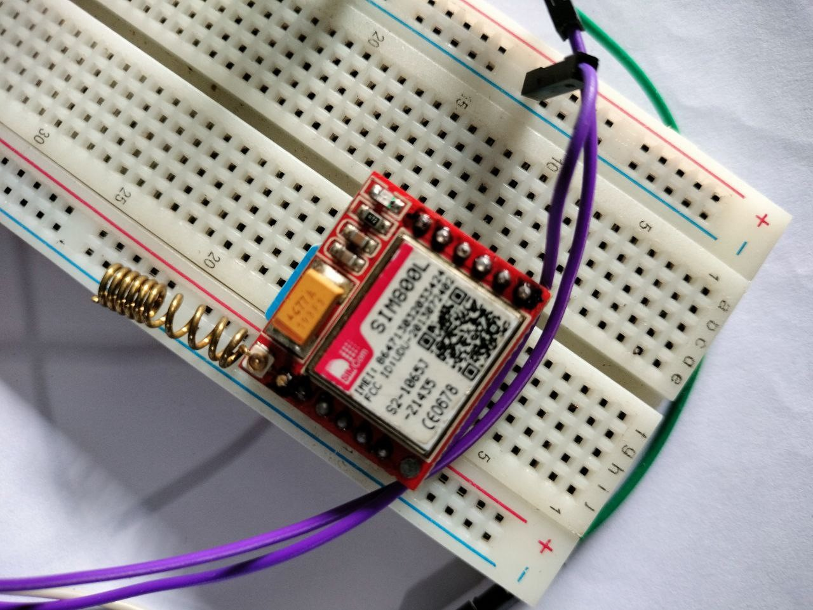
Tea Garden Automated Sprinkler System using IoT
Name: Shariar Hasan ID: 18701012
Supervisor Name: Dr. Mohammad Sanaullah Chowdhury
Department of Computer Science & Engineering, University of Chittagong
Introduction
Motivations and Problem Statement
Literature Review
M. N. Rajkumar, S. Abinaya, and V. V. Kumar, “Intelligent irrigation system—an IoT based approach,” in 2017 International Conference on Innovations in Green Energy and Healthcare Technologies (IGEHT), pp. 1–5, IEEE, 2017.
R. N. Rao and B. Sridhar, “IoT based smart crop-field monitoring and automation irrigation system,” in 2018 2nd International Conference on Inventive Systems and Control (ICISC), pp. 478–483, IEEE, 2018
Tradition irrigation systems limitation:
Map Facility
Improper use of the water | Depends on humidity/ rain
Damage of Plants | Economic Impact
Live News
Engaging UI
Tea gardens often located in hilly areas.
Traditional methods of irrigation are difficult.
Automated System can deliver water directly to the roots of the plants.
Admin Supervision
Fake News Detection
News Upload
Proposed System
Methodology
Fig-1 : Block diagram of the proposed system
Fig-2 : Flow Chart of the proposed system
Implementations
Fig-3 : Main controller connection
Fig-4: Sensor Connection
Fig-5 : GSM Module connection
Conclusion
Future Works
Proposed and implemented a cost effective automated irrigation system.
The system can make agriculture more sustainable.
The system provide better economic impact
Implement a mobile app to monitor the system.
The system will improve more prediction for the best crops to grow in specific environment.

